Slide 1

GOV.UK Verify
E-government Conference December 2015
Robin Walker
GDS
G

Slide 2
1. UK approach to digital services
2. How we’ve applied it to identity
3. The market in identity
4. eIDAS & what happens next
Notes:
Really, this is a continuum of digital transformation – a journey we’re still on and learning from.
Good to make the point now – the ‘we’ in this is the UK government. It’s not just GDS. There are a lot of us working on these problems and it’s that cross-government approach that is really driving change.

Slide 3
1. UK approach to digital services
Notes:
Really, this is a continuum of digital transformation – a journey we’re still on and learning from.
Good to make the point now – the ‘we’ in this is the UK government. It’s not just GDS. There are a lot of us working on these problems and it’s that cross-government approach that is really driving change.

Slide 4
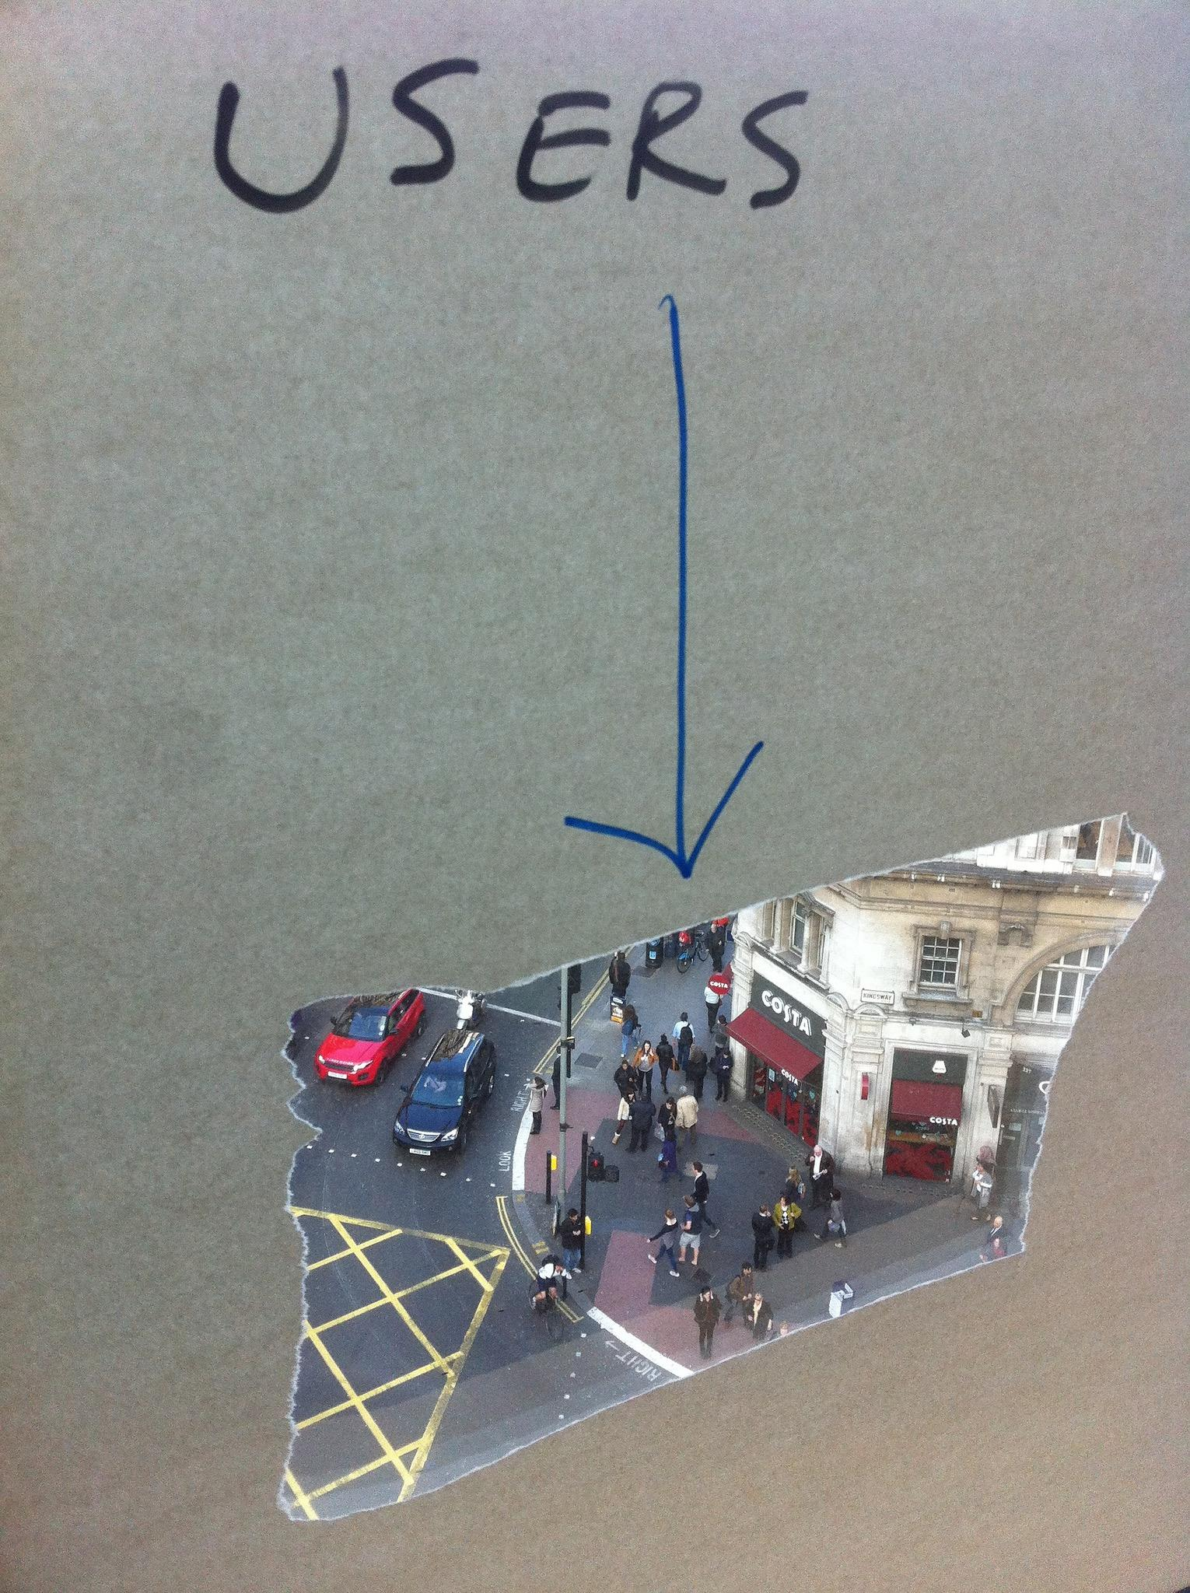
Digital services start with
user needs
GDS
Notes:
Have to start with the user, not with the current process. What do they need? Based on data and actual evidence.

Slide 5
We put users at the heart of everything we do
GDS
Notes:
Have to start with the user, not with the current process. What do they need? Based on data and actual evidence.

Slide 6

Here’s why
GDS

Slide 7
Use modern, agile techniques to build prototypes and rapidly iterate
GDS
Notes:
As I said before, we use modern, agile techniques to build prototypes and rapidly iterate

Slide 8
This has lead us to challenge some of the ways government operates…
GDS
Notes:
Which has meant challenging the way things usually work in government

Slide 9
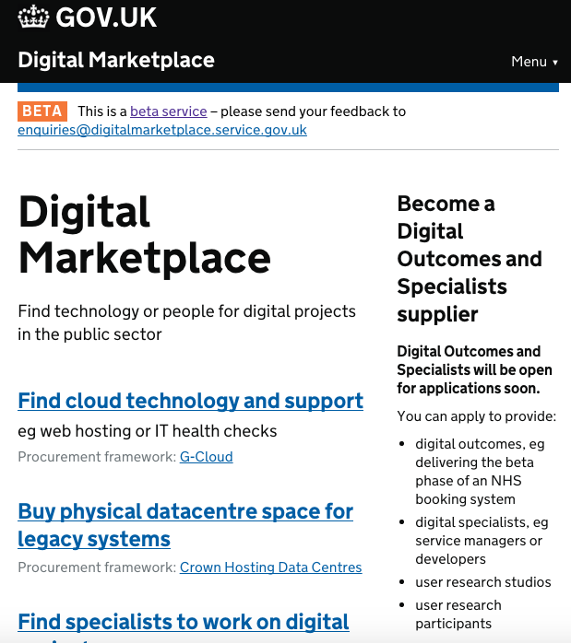
Changing our approach to suppliers
www.gov.uk/digital-marketplace
GDS
Notes:
We’ve had to change our approach to suppliers – disaggregating contracts, opening up the supplier base, improving our knowledge as buyers across government

Slide 10
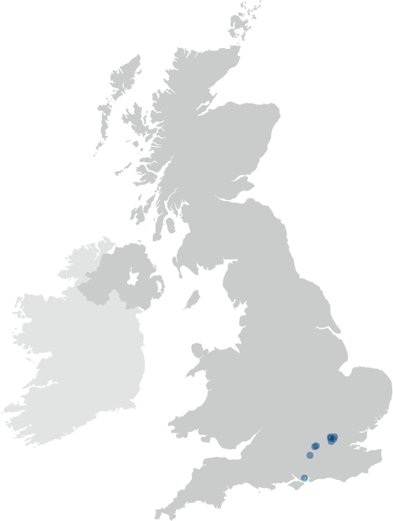
Transforming our supplier base from this…
www.gov.uk/digital-marketplace
GDS
Notes:
In 2009 our technology spending was in a very locked down landscape

Slide 11
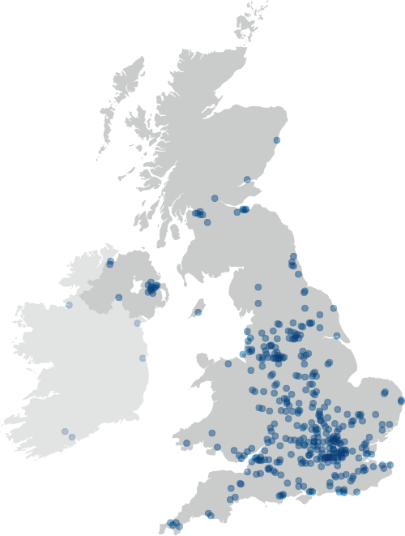
To this…
www.gov.uk/digital-marketplace
GDS
Notes:
That’s now far more open thanks to the digital marketplace, G-cloud etc. There’s more work to be done, but this is stimulating a new technology sector and that’s really important

Slide 12
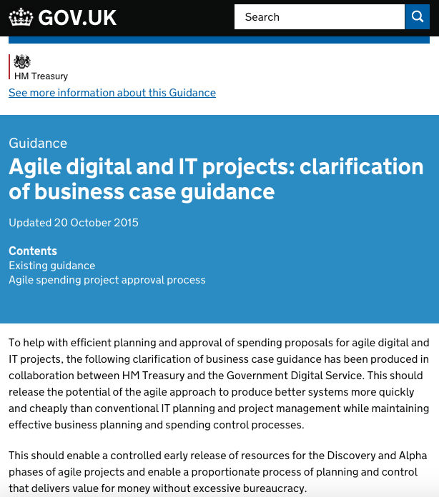
Changing the way project funding works
www.gov.uk/government/publications/the-green-book-appraisal-and-evaluation-in-central-governent/agile-systems-projects-a-clarification-of-business-case-guidance
GDS
Notes:
We worked with Treasury to issue guidance for building agile projects – releasing funding in ways that make snese for building small, iterating and improving services over time

Slide 13
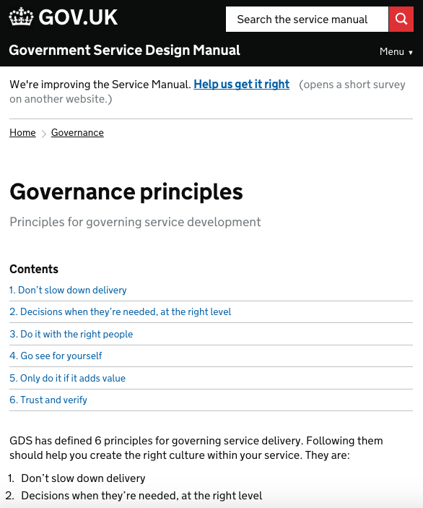
Governance models that work alongside agile delivery
www.gov.uk/service-manual/governance/governance-principles
GDS
Notes:
Making sure that governance works alongside development – a process rather than monolithic gateways where problems might not surface until too late.

Slide 14
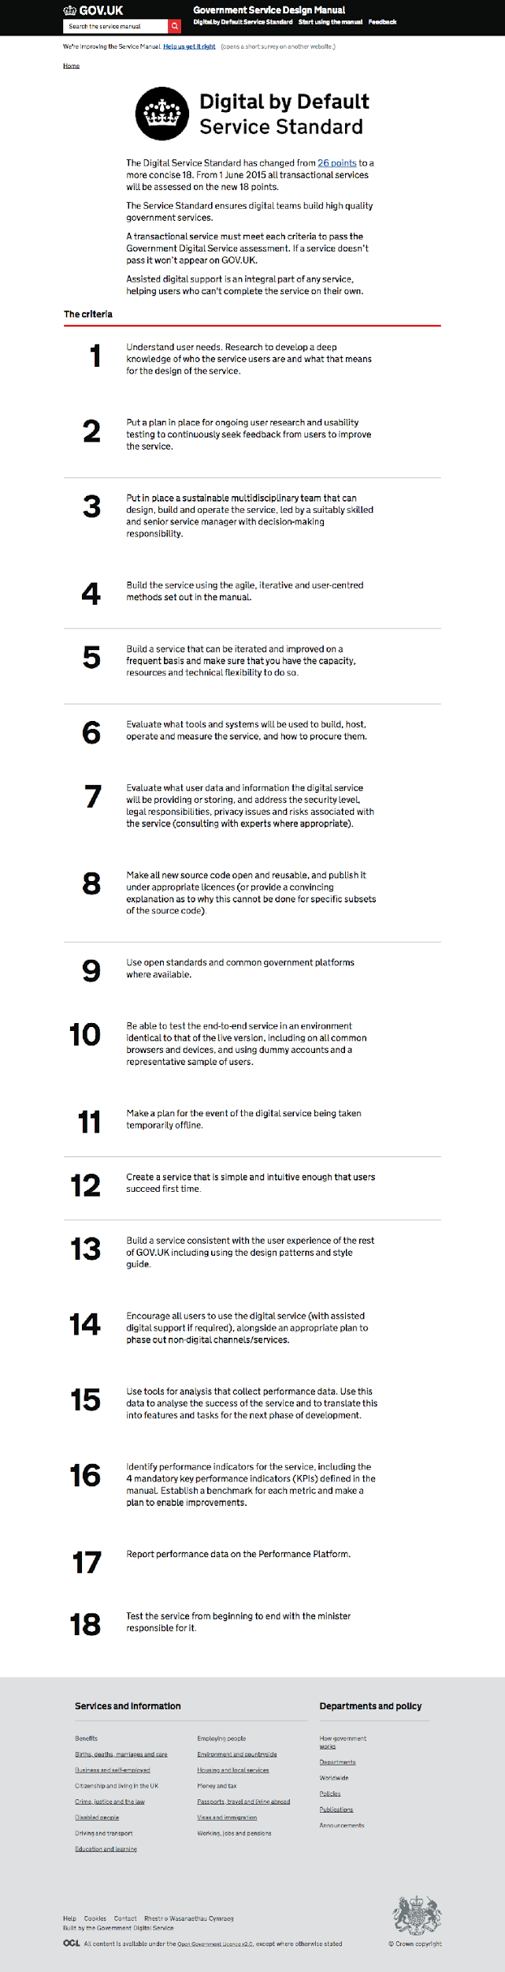
Standards for best practice that iterate over time
www.gov.uk/service-manual/digital-by-default
GDS
Notes:
And standards which encourage best practise, which have evolved over the last two years to be even more useful to teams working on this stuff.

Slide 15
These are the ways modern digital organisations operate - some of it has been new to government
GDS
Notes:
These are the ways modern digital organisations work, but it has been a learning curve across government. But it’s not in a vacuum…

Slide 16
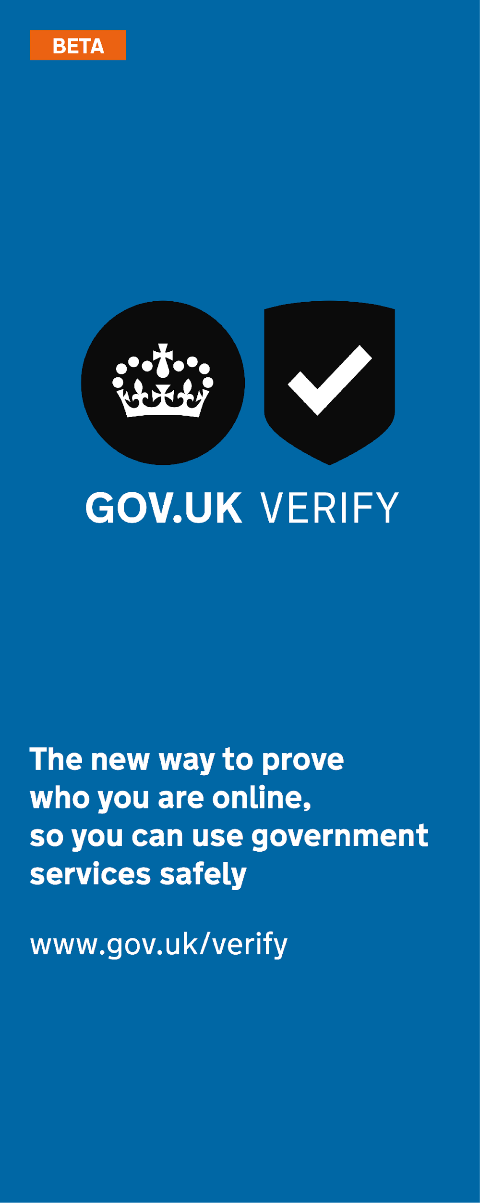
GOV.UK
25 redesigned services
GOV.UK Verify
Performance Platform
Assisted digital support
Digital skills in government
Digital Marketplace
Better, cheaper technology
Saved billions
www.gov.uk/verify
GDS
Notes:
GOV.UK Verify – the new way to prove who you are to government. A platform for identity

Slide 17
2. How we’ve applied it to identity
Notes:
Really, this is a continuum of digital transformation – a journey we’re still on and learning from.
Good to make the point now – the ‘we’ in this is the UK government. It’s not just GDS. There are a lot of us working on these problems and it’s that cross-government approach that is really driving change.

Slide 18
Users need a convenient and safe way to access digital services

Slide 19
GOV.UK Verify is the new way to prove who you are online.
It helps fight the growing problem of online identity theft. It stops someone pretending to be you.

Slide 20
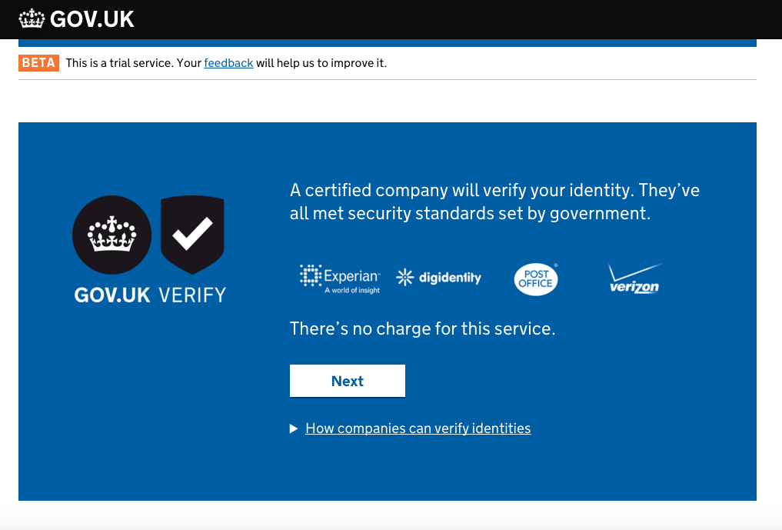

Slide 21
A short video about GOV.UK Verify

Slide 22

There’s no central database or common identifier.
With no single point of failure, the service is more resilient.

Slide 23
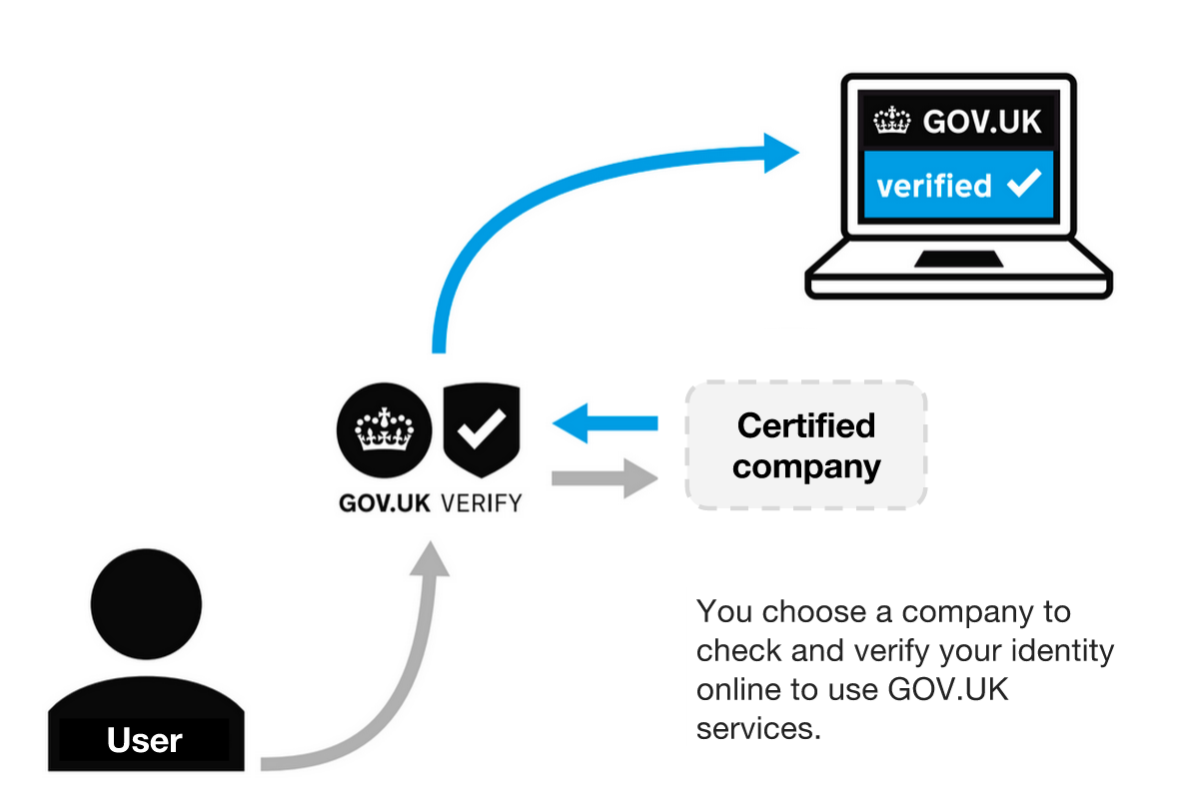
How GOV.UK Verify
works

Slide 24
Working with users

Slide 25
What do we mean by user research?
Observing real users attempting to complete realistic tasks with a real (or simulated) product

Slide 26
What do we mean by user research?
Watching and learning from what happens

Slide 27
What do we mean by user research?
Iterating the product based on what you learn

Slide 28
What do we mean by user research?
Trying again to see if you got it right

Slide 29
It’s about what people do, not what they say
“I can’t stand the way GOV.UK looks, it’s so boring, they should add pictures, or a bit of colour”
We often hear this from our users. We ignore it
We design GOV.UK to be the most usable and effective it can be
We design the site so people can easily do what they need to, not for them to like it
We watch what people do in research more than we listen to what they say

Slide 30
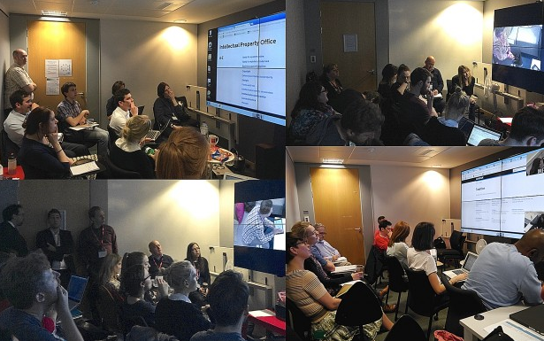
Notes:
They expect government to know more about them than identity providers
They expect Verify to behave like a conventional registration process

Slide 31
Why do user research for GOV.UK Verify?
Service design starts with identifying user needs.
If you don’t know what the user needs are, you won’t build the right thing.

Slide 32
Why do user research for GOV.UK Verify?
We do user research so we don’t make assumptions about those needs and can understand the behaviour of our users and what they might want from a digital service.

Slide 33
Why do user research for GOV.UK Verify?
Designing a straightforward user journey is hard. Many of our users find the proposition of GOV.UK Verify novel, and even counter-intuitive. User research throughout GOV.UK Verify’s development has helped identify where we can make the journey clearer.

Slide 34
3. The market in identity
Notes:
Really, this is a continuum of digital transformation – a journey we’re still on and learning from.
Good to make the point now – the ‘we’ in this is the UK government. It’s not just GDS. There are a lot of us working on these problems and it’s that cross-government approach that is really driving change.

Slide 35
Growing the market by setting outcome-based standards
Notes:
We are aggregating demand across central government departments and agencies.

Slide 36
A market-based approach embraces:
user choice
user privacy
rapidly developing threats & markets
meeting wider needs - public & private
GDS

Slide 37
A market-based approach embraces:
user choice
user privacy
rapidly developing threats & markets
meeting wider needs - public & private
GDS

Slide 38
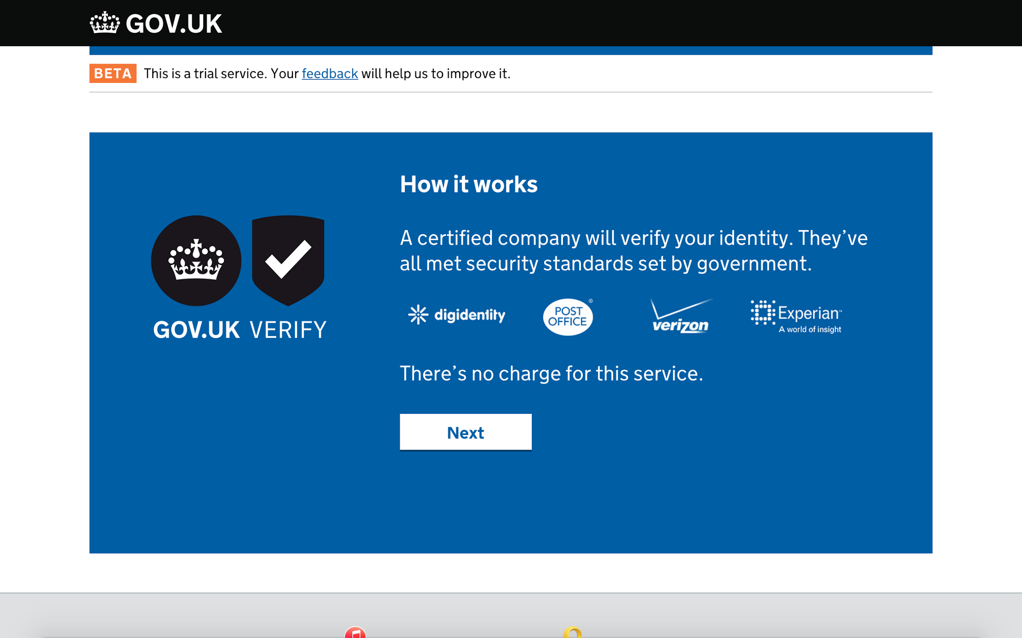

Slide 39
New providers coming soon:
Barclays
Paypal
GB group
Morpho
Royal Mail
GDS
GDS

Slide 40
A market-based approach embraces:
user choice
user privacy
rapidly developing threats & markets
meeting wider needs - public & private
GDS

Slide 41
Worked with independent privacy and consumer advisory groups to develop nine principles for identity assurance.

Slide 42
Working with certified companies strictly limits the information government or any certified company holds.
No-one has more information than they need to perform their function.

Slide 43
A market-based approach embraces:
user choice
user privacy
rapidly developing threats & markets
meeting wider needs - public & private
GDS

Slide 44

GDS

Slide 45
A market-based approach embraces:
user choice
user privacy
rapidly developing threats & markets
meeting wider needs - public & private
GDS

Slide 46
The cost of identity services in the UK has been estimated at £3.3bn
Federated approaches like GOV.UK Verify could reduce these costs by 90%
(source: https://www.ctrl-shift.co.uk/news/2014/06/09/the-economics-of-identity/)
GDS

Slide 47
In 2014:
41% of all fraud was identity fraud
84% of identity fraud was online
(Source: CIFAS)
GDS

Slide 48
4. eIDAS & what happens next
Notes:
Really, this is a continuum of digital transformation – a journey we’re still on and learning from.
Good to make the point now – the ‘we’ in this is the UK government. It’s not just GDS. There are a lot of us working on these problems and it’s that cross-government approach that is really driving change.

Slide 49
Where do we go now with eIDAS?
eIDAS provides trust and interoperability
We have to make it work for users
We should also look at how secure identity can be available to the private sector
GDS

Slide 50

Working with industry via the Open Identity Exchange
Projects have included investigating private sector needs for identity assurance and opening a UK bank account with a Norwegian digital identity.
GDS
*

Slide 51
Digital identities change what we can do with the internet……….let’s work with users to understand what they want to do with that.
Notes:
We are aggregating demand across central government departments and agencies.

Slide 52
Thank-you
GOV.UK Verify
E-government Conference December 2015
Robin Walker
GOV.UK Verify
GDS
G

Slide 53
Information
Transformation programme gov.uk/transformation
Identity assurance guidance in the Service Design Manual
Essential Good Practice Guides and Technical Specifications
Identity assurance programme blog: https://identityassurance.blog.gov.uk/
GOV.UK Verify Performance Platform:
https://www.gov.uk/performance/govuk-verify

